Slide 1
FOOT STEP POWER GENERATOR
TEAM MEMBERS
CB.SC.U4AIE24106-HARSHA .C
CB.SC.U4AIE24137-PRANEETH .M
CB.SC.U4AIE24145-ROHITH .P
CB.SC.U4AIE24139-SUPREETH .N

Slide 2
INTRODUCTION
Footstep Power Generator is a project that turns our steps into electrical energy using piezoelectric discs.
It will display us how much voltage generated and how many times we stepped on it.
This energy can be stored or used to power small devices.

Slide 3
objectives
Develop a system that converts mechanical energy from footsteps into electrical power using piezoelectric discs, effectively.
Implement a sensor-based step counter to track how many times a user steps on the system.
Develop a responsive HTML-based web page to visually present step count and power generation data, accessible via mobile devices.

Slide 4
COMPONENTS USED
Arduino uno
10uf capacitors
1N4007 diodes
BC547 transistor
Piezoelectric disc Resistors
LCD i2c display
18650 cell
Led strip
HC-05 Bluetooth module

Slide 5
METHODOLOGY
When a footstep applies pressure on the platform, the piezoelectric discs get compressed.
Due to the piezoelectric effect, this sensors generate a small AC voltage.
The AC voltage generated by the piezoelectric sensors is not suitable for direct storage, so it must be converted to DC
The 1N4007 diodes allow current to flow in only one direction, ensuring proper DC conversion.
The 10µF capacitor stabilizes the DC output .
The rectified and smoothed DC voltage is stored in 18650 lithium-ion cells.

Slide 6
The BC547 transistor is used for power regulation, ensuring controlled charging of the battery.
The Arduino Uno reads the voltage generated by the piezo sensors
Since the battery voltage might be higher than the Arduino's input range (0-5V), by using resistors we can easily bring it within safe limits.
the Arduino takes the measured voltage and processes it using an analog-to-digital converter.
And this processed voltage values and step counts are sent to the LCD I2C display, which we can see it on the display.
the energy which is stored in the 18650 battery, is used to power an LED strip.

Slide 7

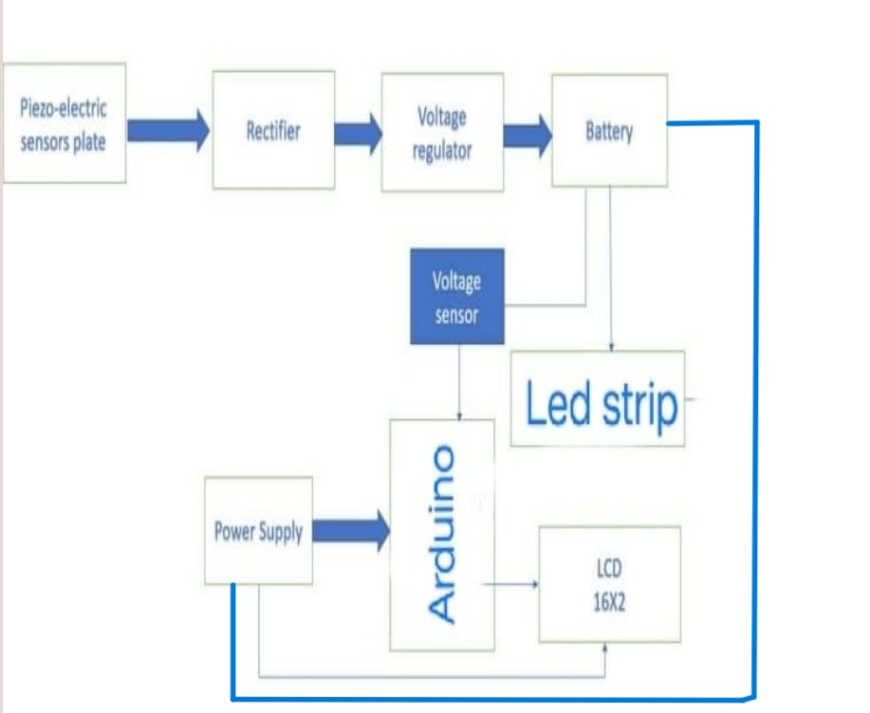
B L O C K D I A G R A M

Slide 8
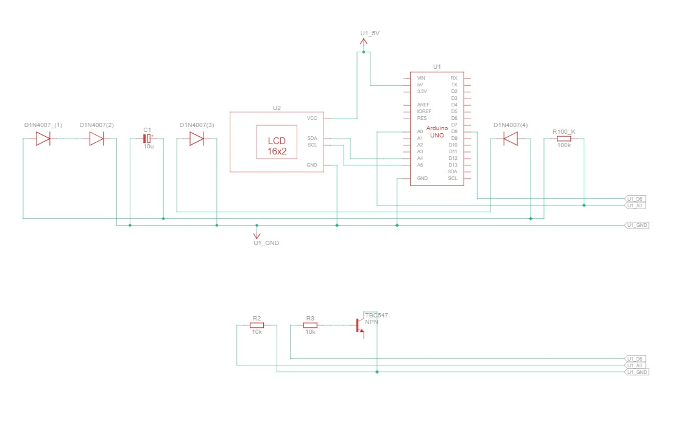
SCHEMATIC DIAGRAM

Slide 9
HC-05 Connections with Arduino-UNO:
1.VCC → Connected to 5V on Arduino
2.GND → Connected to GND on Arduino
3.TX → Connected to RX (Pin 0)
4 .RX → Connected to TX (Pin 1)
LCD-I2C module Connections with Arduino-UNO:
1. POWER PINS:
VCC → CONNECTED TO 5V ON ARDUINO
GND → CONNECTED TO GND ON ARDUINO
2. DATA PINS:
SDA (SERIAL DATA LINE) →CONNECTED TO A4 ON ARDUINO
SCL (SERIAL CLOCK LINE) → CONNECTED TO A5 ON ARDUINO

Slide 10
FUTURE SCOPE
•We can make it more efficient by using improved materials and store energy in more effective ways. By introducing Smart technologies like IoT and AI to it we can track and manage the power.
•We can make it more effective by introducing wireless charging to it so that the stored energy from shoes or floors to directly charge devices without cables
•This can work together with solar panels and wind turbines by storing all the generated energy in a common battery and we can use this stored energy in different ways

Slide 11
CONCLUSION
•hence footstep power generator is a very efficient and eco friendly method to convert the mechanical energy into electrical energy. piezo electric effect plays a key role in this project and finally energy which is being wasted can be harvested with this. the harvested energy can be used in different ways in different places and further improvements can be made by combining it with various methods and technologies to improve energy harvesting.

Slide 12
REFERENCEs
https://youtu.be/YZ4OBxyyqOg?si=PlaiS7aDfRq7t1_Y
Piezoelectric Energy Harvest for Wearable Devices | IEEE Conference Publication | IEEE Xplore
Piezoelectric Based Power Generation For Portable Charging System | IEEE Conference Publication | IEEE Xplore

Slide 13
THANK YOU

